Slide 1

THANK YOU FOR DOWNLOADING!
Hope it helps with your presentations!
In case the embedded fonts don’t work, here are the download links:
Dimensions
https://www.deviantart.com/honyhell/art/NCT-127-2-Baddies-Font-By-Honyhell-932717610
Inter
https://www.fontsquirrel.com/fonts/inter

Slide 2
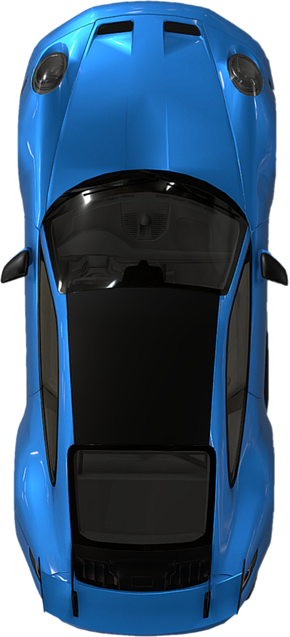



2 BADDIES
1 PORSCHE

Slide 3
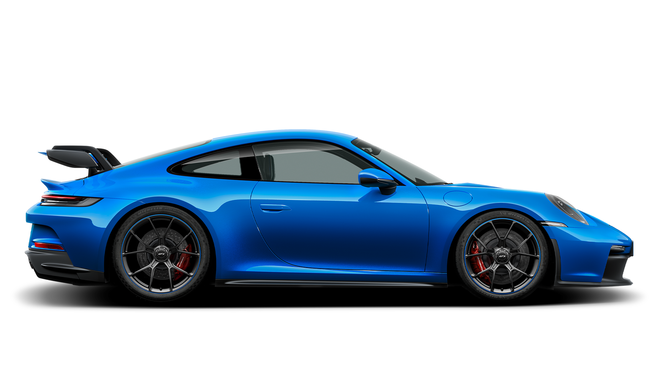
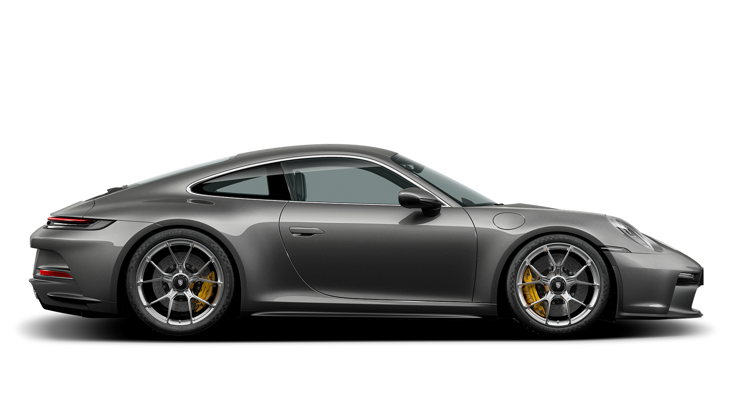
2 BADDIES
1 PORSCHE

Slide 4
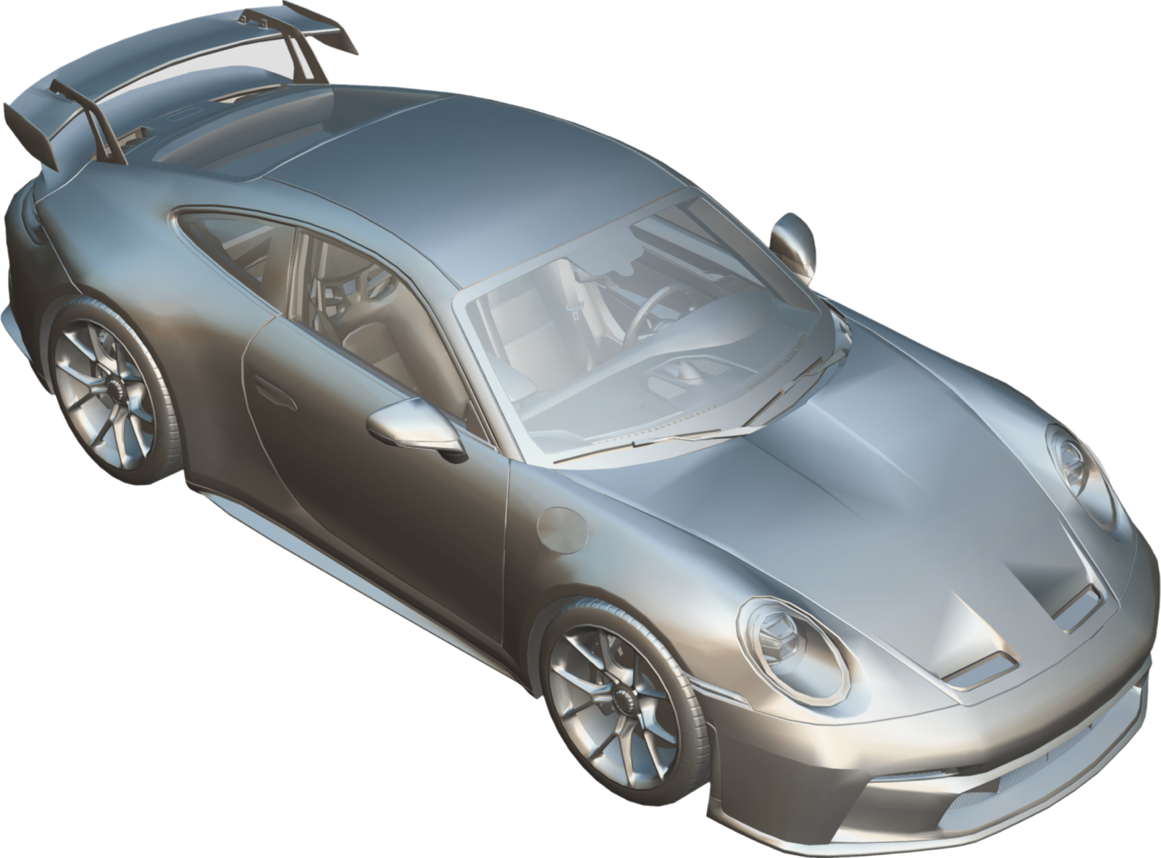





$162,450
PRICE
PORSCHE 911 GT3
PORSCHE
375KW
POWER
911 GT3
3.4S
ACCELERATION
911 HAS BUILT A REPUTATION FOR ITSELF AS ONE OF THE MOST VERSATILE AND IMPORTANT PERFORMANCE CARS IN MOTORING HISTORY.
318KM/H
TOP SPEED
2 BADDIES
1 PORSCHE

Slide 5
THE MOST VERSATILE SPORTS CAR
THE 911 IS THE ONLY CAR THAT YOU CAN TAKE ON A SAFARI THROUGH AFRICA, COMPETE IN THE 24 HOURS OF LE MANS AND GO TO THE THEATRE AND DRIVE THROUGH THE STREETS OF NEW YORK.

Slide 6
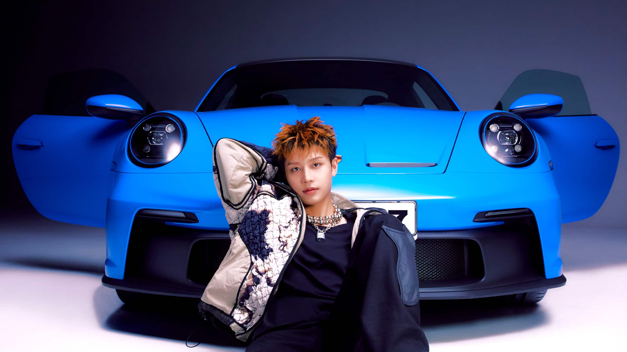
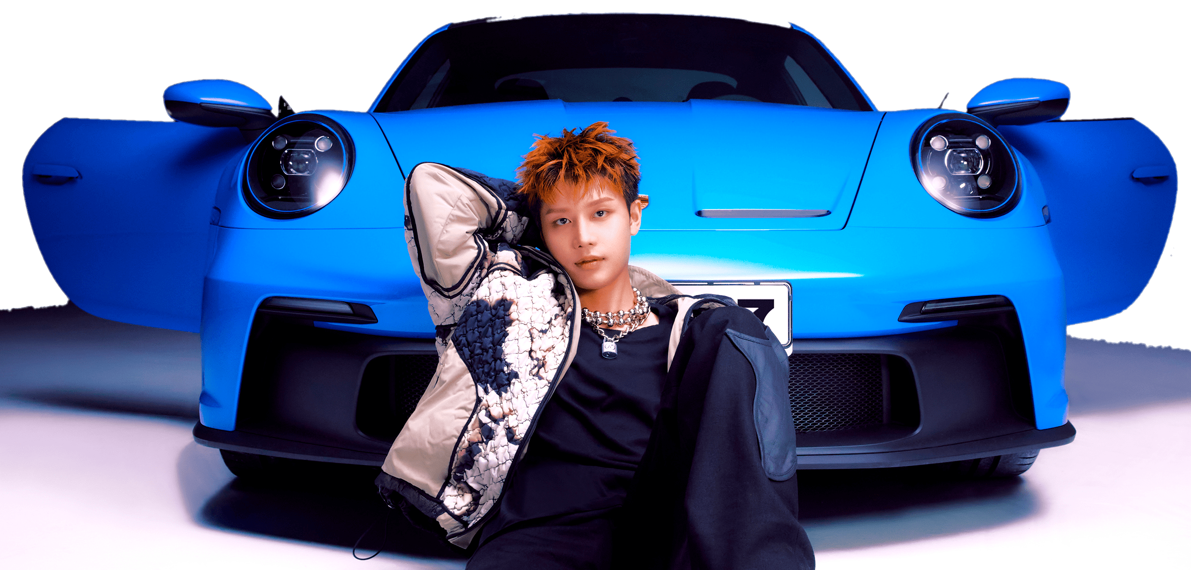
CROSSOVER WITH FASHION
PORSCHE HAS EXPANDED ITS REACH INTO THE WORLD OF FASHION BY COLLABORATING WITH A GROWING NUMBER OF FASHION BRANDS TO HELP INSPIRE A NEW GENERATION OF CAR ENTHUSIASTS TO ENGAGE WITH THE BRAND.

Slide 7
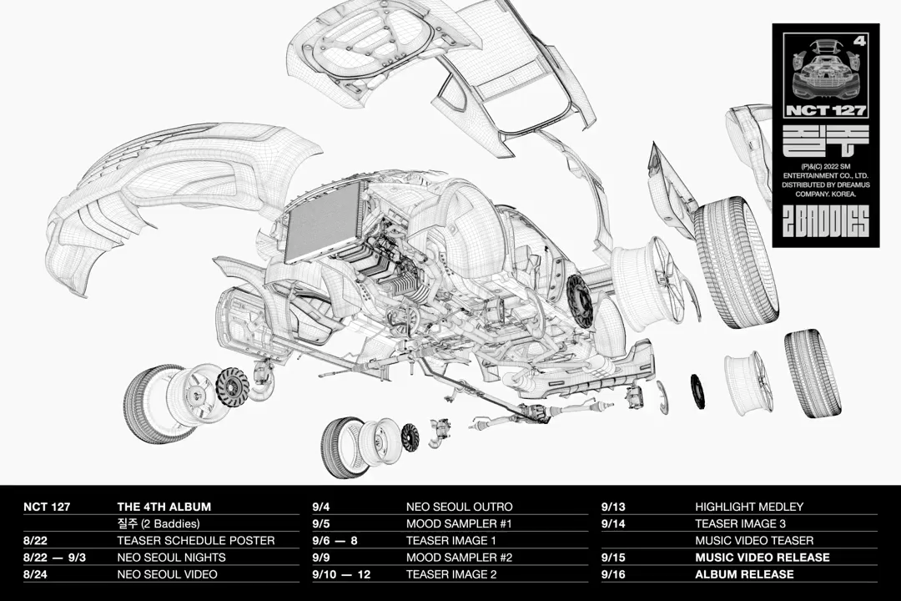
TIMELESS
DESIGN
ITS SHAPE IS UNMISTAKABLE BECAUSE OF ITS ICONIC FLYLINE AND ELEGANT ROOF LINES, SIMPLE GESTURES THAT HAVE CHARACTERIZED PORSCHE SINCE THE BEGINNING.
“THERE’S ONLY A FEW AUTOMOTIVE SHAPES THAT YOU CAN SPLASH ON A WALL AND EVEN THOSE WHO AREN’T CAR ENTHUSIASTS WILL SAY, “OH I KNOW WHAT THAT IS.”

Slide 8
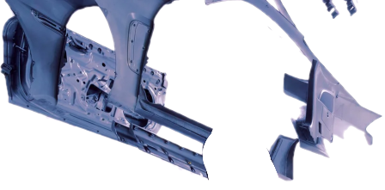
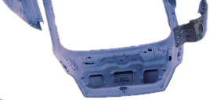
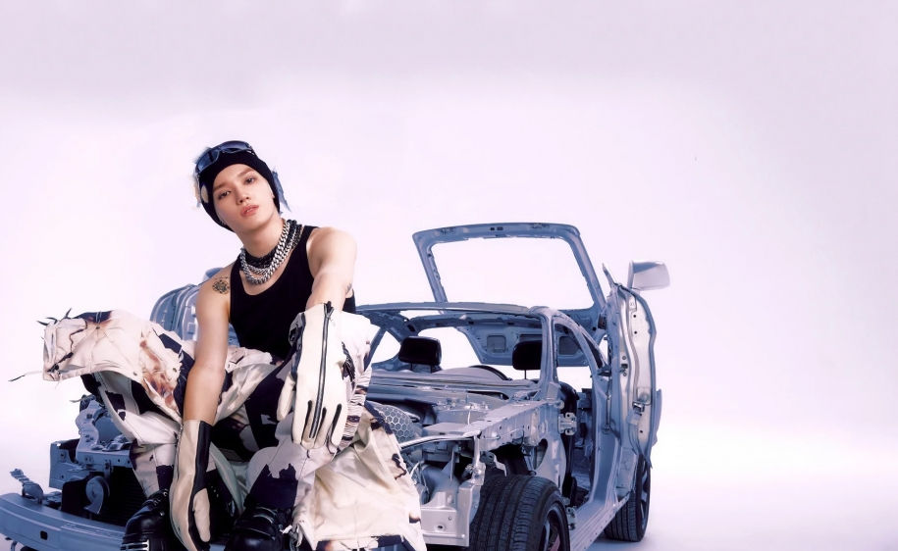
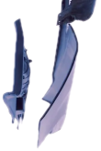


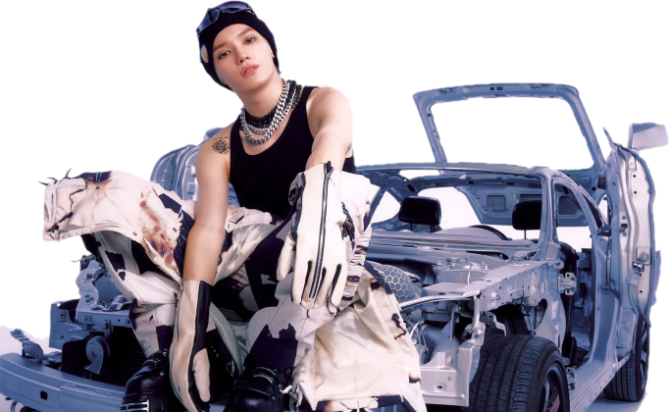
THE ULTIMATE CANVAS FOR EXPRESSION
BEYOND THE WORLD OF CAR TUNING WORKSHOPS AND GARAGES, 911’S HAVE TAKEN ON NEW LIFE THROUGH THE DAB HANDS OF INTERNATIONAL ARTISTS THAT HAVE TURNED THEM INTO LANDMARK PIECES OF AUTOMOTIVE ART.

